Slide 1
Legislative Documents
Joshua Huder
Senior Fellow
Government Affairs Institute at Georgetown University

Slide 2
Forms of legislation
H.R. or an S. – Bills
Become public laws
H.J. Res. or S.J. Res. – Joint Resolutions
Usually for constitutional amendments but also can be law (e.g. continuing resolutions)
H. Res. or S. Res. – Simple Resolutions
Pass a single chamber
H. Con. Res. – Concurrent Resolutions
Pass both chambers but no presidential signature
Notes:
Four kinds of bills – Different bills for different things. Have different requirements.
Bills (House-Senate-President: become public law)
Joint Resolutions - also become public law but normally constitutional amendments, etc.
Simple resolutions – pass one chamber
Concurrent resolutions – pass two chambers

Slide 3
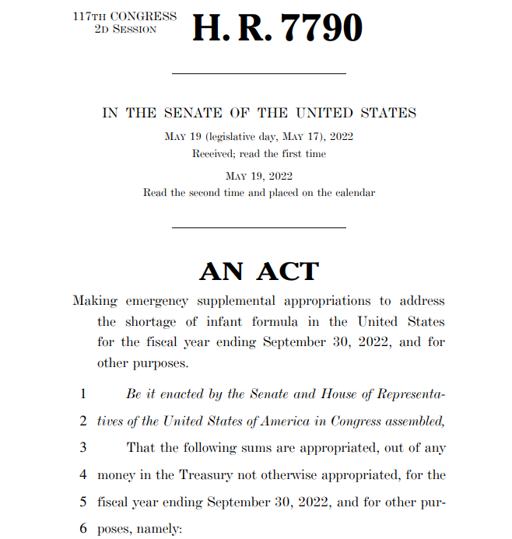
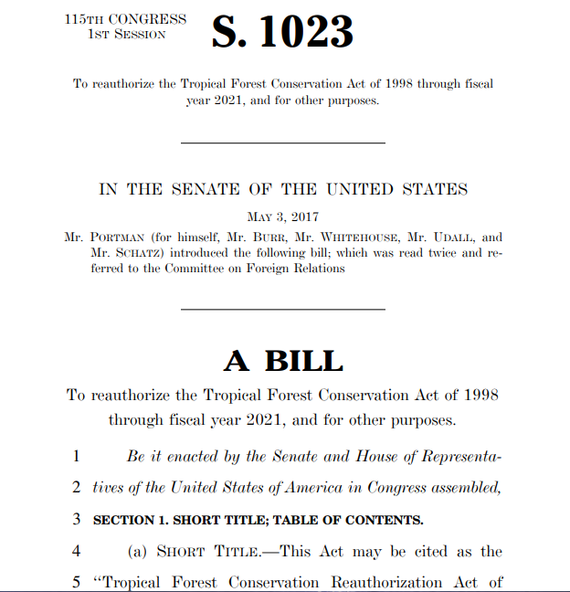
H.r. or S. – Propose public law
Notes:
House + Senate + President
Cosponsors. Referral.
House bill says “in the Senate”

Slide 4
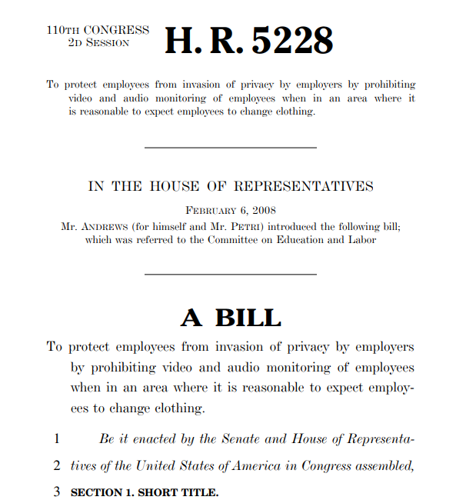
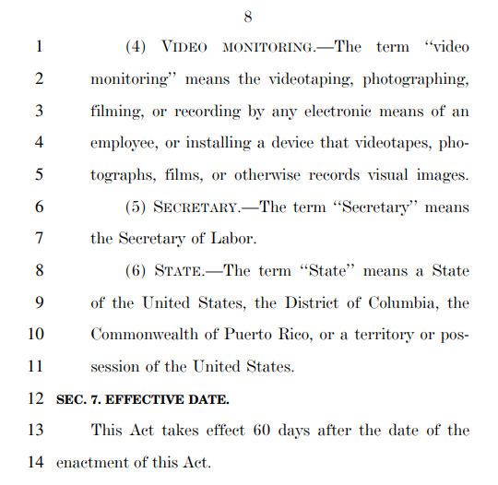
H.r. or S. – Public laws
Notes:
Effective date.
Affordable care act example

Slide 5
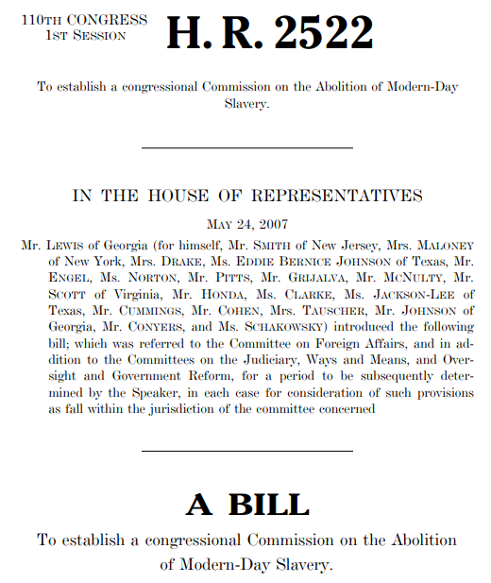
Public laws – Multiple referrals
Notes:
Bills referred to committee
Done by parliamentarian
Each committee examines provisions within jurisdiction
This bill touches foreign affairs (primary referral), judiciary, Ways and Means, and Oversight.
Speaker can put time limit on consideration
Effectively discharge
Most legislation, non-major, voluntarily discharged by committees.
Chairs write letter saying their concerns will be addressed by other committee, formally discharge bill from committee.

Slide 6
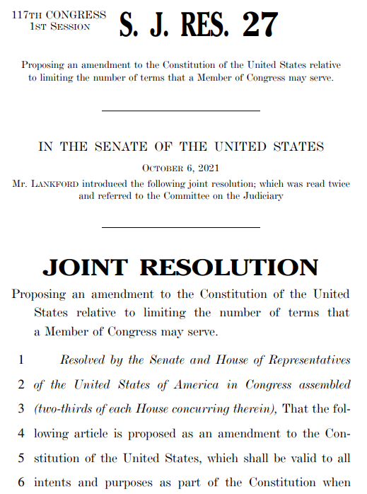
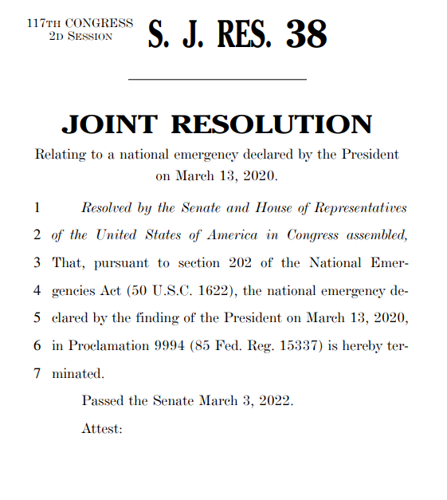
Joint Resolutions
Notes:
Joint resolutions (House + Senate + President)
Continuing resolutions or emergency appropriations
Resolutions passed by Congress that reverse executive action
Emergency declarations
War Powers resolutions
Congressional review act
Constitutional amendments (do not need presidential signature)

Slide 7
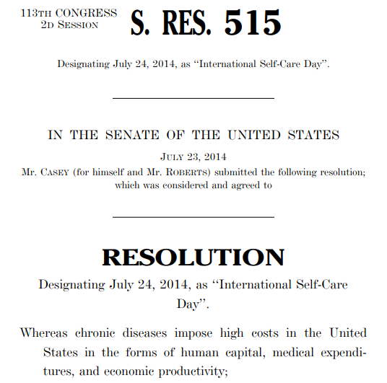
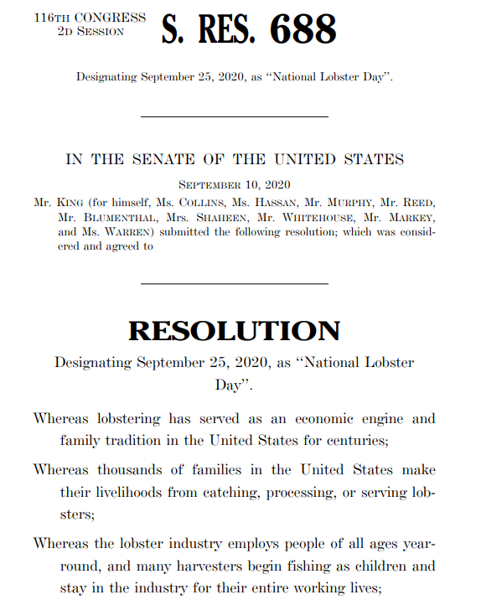
Simple Resolutions - minor
Notes:
Pass one chamber. Not law.
Most often used for minor purposes. Things dedicating national day, raising awareness. Symbolic gestures.
Example (right) Senator Angus King.
What do you do when you’re a senator representing Maine? You make a National Lobster Day.

Slide 8
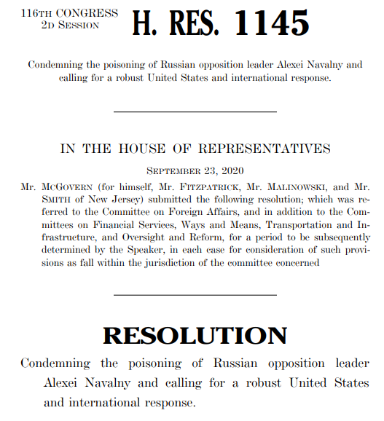
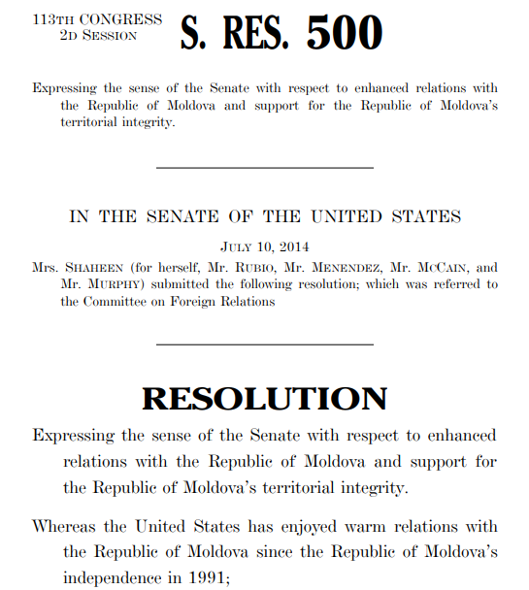
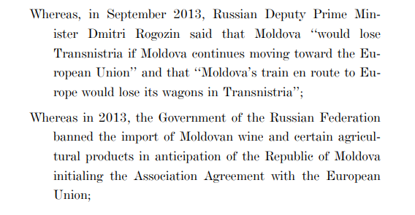
Simple resolutions - major
Notes:
Simple resolutions can have significant effect as major sign of support. address chamber interest in treaties, trade deals, diplomatic relations
In these cases, simple resolutions addressing poisoning of Russian opposition leader Navalny
Or, Russian actions as it relates to the Republic of Maldova and its interest in joining the EU.
Signal to the administration, agencies, foreign governments, international organizations, and others a signal of intent.

Slide 9
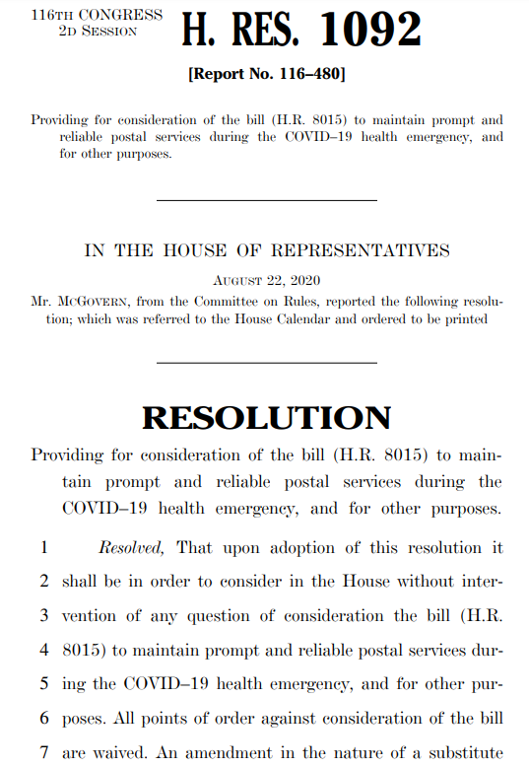
Simple Resolutions - Special Rule from the House Rules Committee
Notes:
Simple resolutions not-binding as laws. Only passes one chamber. But within that chamber, they are effectively laws.
Special rule from Rules Committee.
Effectively violates all house rules.
Explain more in next talk.
Senate altered filibuster process in 2013 using a simple resolution.
S.Res. Limited debate if majority leader and minority leader agreed. Allowed for 4 amendments.
If majority passes something, binds the entire chamber.
Not true of a bill. Passes one chamber and not other.
House passed new budget bill and sent it to Senate, but Senate did nothing, bill would not bind House. Must become law to do that.

Slide 10
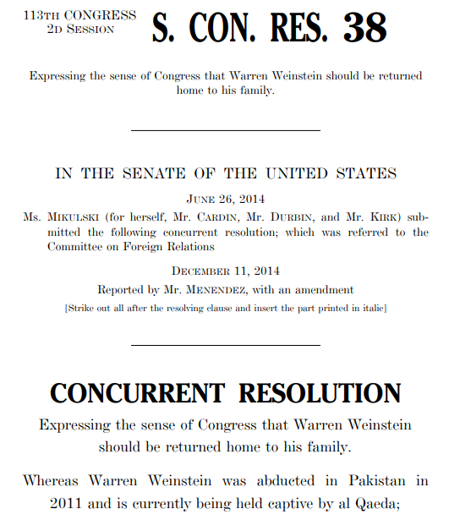
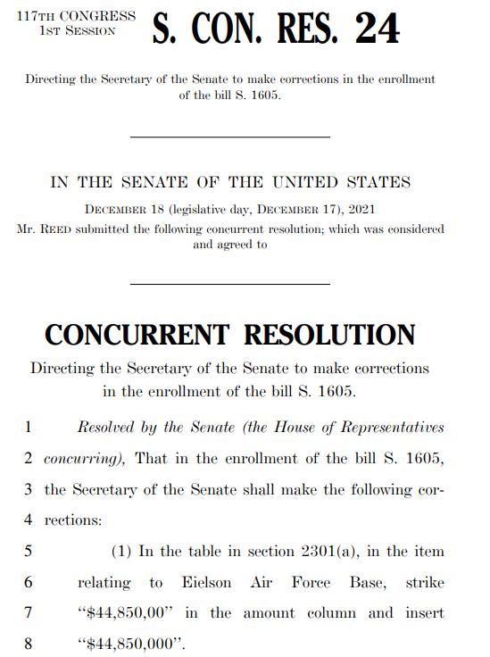
Concurrent Resolutions
Notes:
Concurrent resolutions
Statement of Congress (example on left)
Enrolling corrections (e.g. on right)
Authorizing use of the Rotunda (lying in state)
Allowing use of Capitol grounds for annual soap box derby
Budget resolutions (procedural effect)

Slide 11
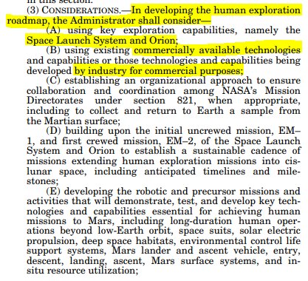
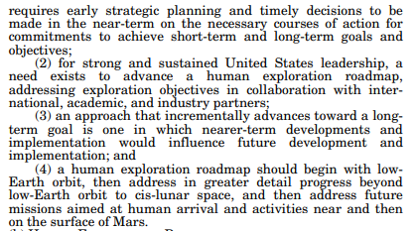
Bill reports
Notes:
Bill reports are critical documents. After committee reports a bill, releases a bill report.
Bill text in lay terms. What bill actually does.

Slide 12
Bill reports – Nasa appropriations example

Slide 13
Conference reports & joint explanatory statements
2 parts of a conference report
“Conference Report”
The final legislative text
Joint Explanatory Statement of Managers
The explanation of what they agreed upon and why (the “report language”)

Slide 14
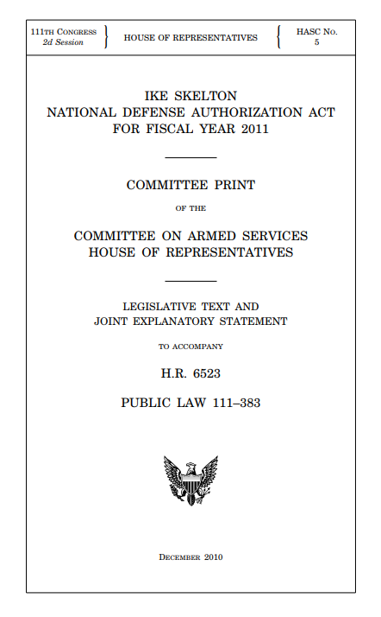
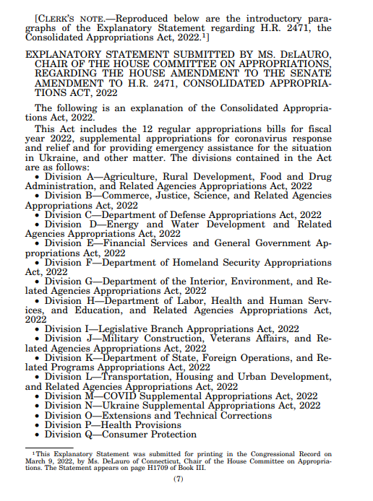
Conference reports (& joint explanatory statements)
Notes:
Conference reports. Legislative text and joint explanatory statement.
If no conference, no conference report.

Slide 15
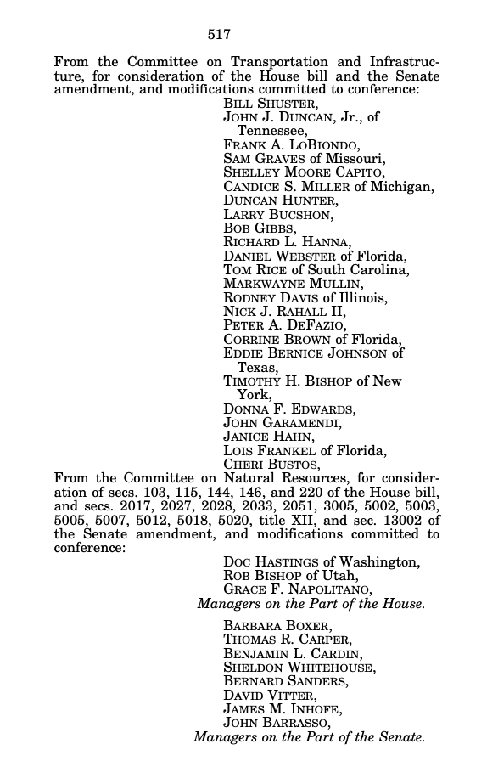
Conference Report

Slide 16
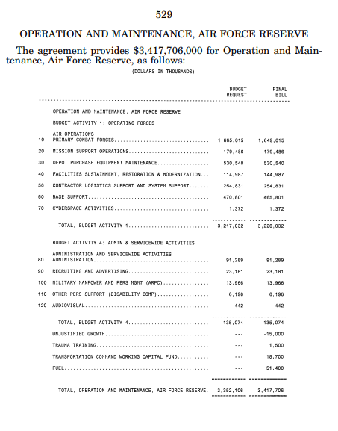
Joint Explanatory Statement

Slide 17
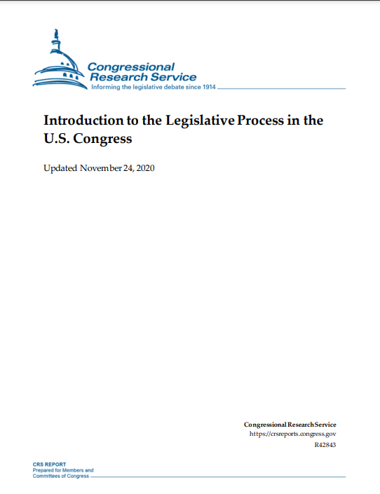
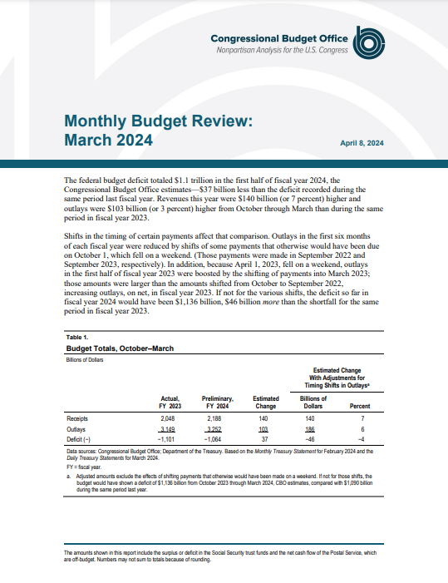
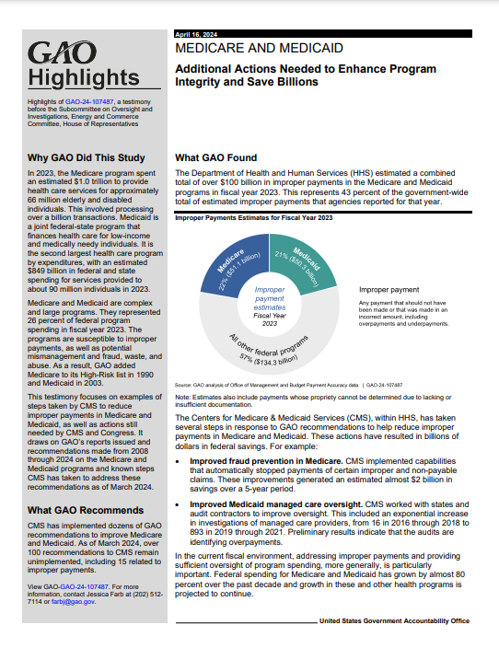
Legislative agency documents
CRS
CBO
GAO

