Slide 2
2024 Election Matters

Slide 3
Senate Balance of Power
50 Democrats, 49 Republicans
1 (Retiring) Sinema

Slide 4
House Balance of Power
221 Republicans | 214 Democrats
Governors Balance of Power
27 Republicans | 23 Democrats

Slide 5
Caucuses by 2020 Presidential Margin​
221
Republican
TRUMP 20+
TRUMP 10-20
TRUMP 0-10
BIDEN WON
111
56
37
17
214
Democrats
BIDEN 20+
BIDEN 10-20
BIDEN 0-10
TRUMP WON
137
46
26
5

Slide 6
Majorities on the Line
Senate:
GOP needs +2
or
+1 + White House
House:
Democrats need +4

Slide 7
Fight for the
White House

Slide 8
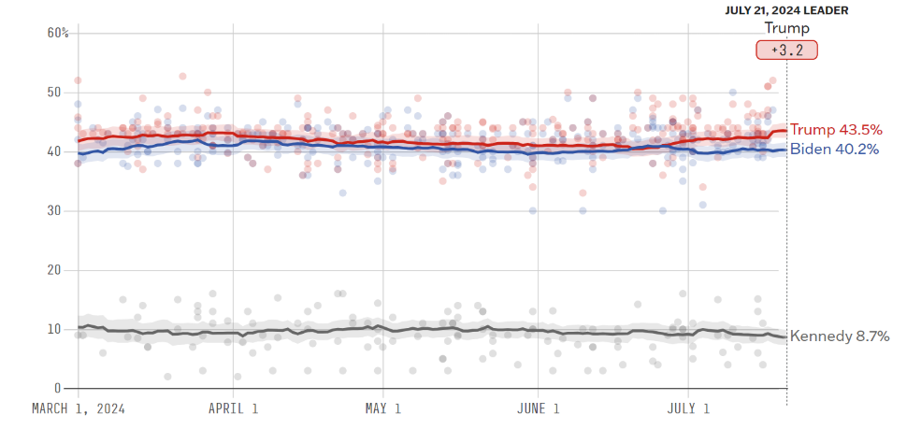
National Polls: Trump vs. Biden

Slide 9
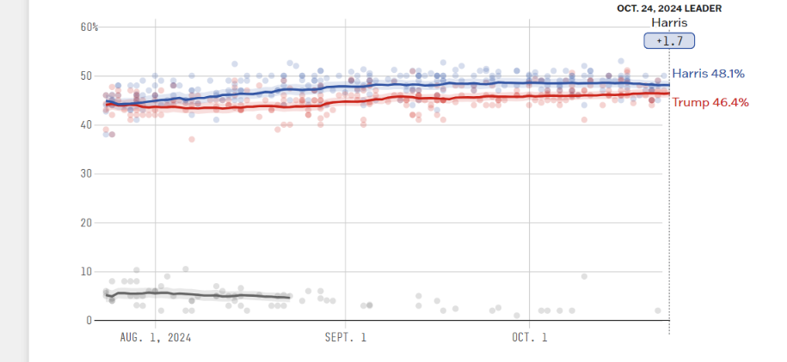
National Polls: Trump vs. Harris

Slide 10
No
National
Elections

Slide 11
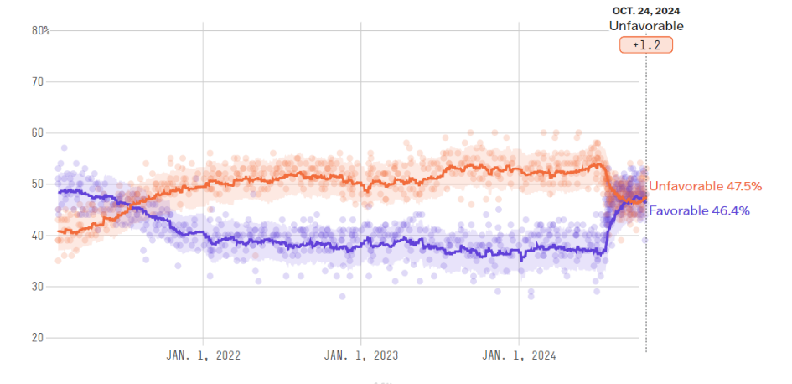
Kamala Harris’ Favorability Rating
Source: FiveThirtyEight

Slide 12
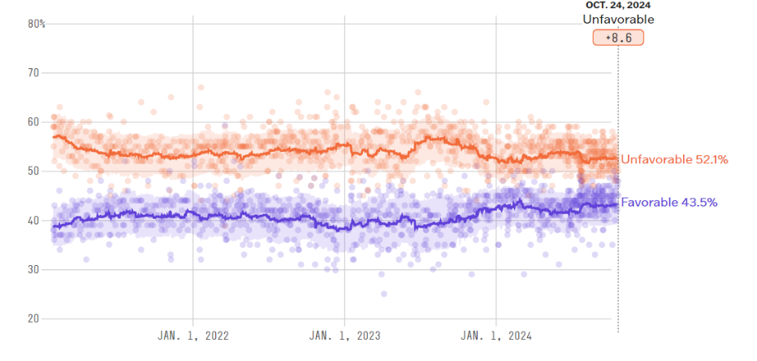
Donald Trump's Favorability Rating
Source: FiveThirtyEight

Slide 13
2024 Presidential Ratings
Democratic Electoral College Votes: 226
Republican Electoral College Votes: 219
SOLID D
LIKELY D
LEAN D
TILT D
TOSS UP
TILT R
LEAN R
LIKELY R
SOLID R
LEAN D
California (54)
Colorado (10)
Connecticut (7)
Delaware (3)
DC (3)
Hawaii (4)
Illinois (19)
Maine 1st (1)
Maryland (10)
Massachusetts (11)
New Jersey (14)
New Mexico (5)
New York (28)
Oregon (8)
Rhode Island (4)
Vermont (3)
Washington (12)
Maine (2)
Virginia (13)
Minnesota (10) New Hampshire (4)
Nebraska 2nd (1)
Arizona (11)
Georgia (16)
Michigan (15)
Nevada (6)
North Carolina (16)
Pennsylvania (19)
Wisconsin (10)
Florida (30)
Maine 2nd (1)
Iowa (6)
Ohio (17)
Texas (40)
Alabama (9)
Alaska (3)
Arkansas (6)
Idaho (4)
Indiana (11)
Kansas (6)
Kentucky (8)
Louisiana (8)
Mississippi (6)
Missouri (10)
Montana (4)
Nebraska (2)
Nebraska 1st (1)
Nebraska 3rd (1)
North Dakota (3)
Oklahoma (7)
South Carolina (9)
South Dakota (3)
Tennessee (11)
Utah (6)
West Virginia (4)
Wyoming (3)
270 Needed to Win

Slide 14
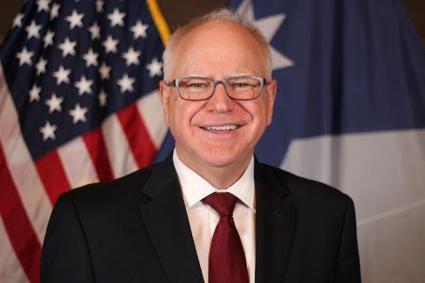
+3%
-8%

Slide 15
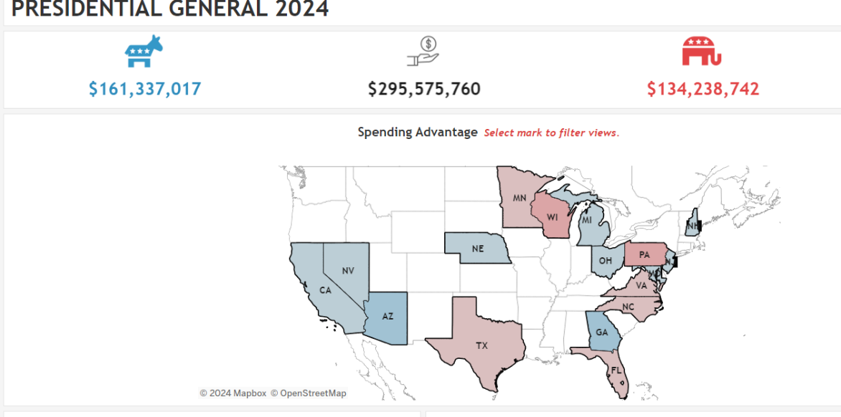

Slide 16
Election State | Democrat Spending | GOP Spending | Democrat Share
PA | $36,479,315 | $43,413,137 | 46%
MI | $22,593,141 | $20,417,683 | 53%
GA | $23,006,264 | $17,068,512 | 57%
WI | $15,992,964 | $20,513,979 | 44%
NC | $14,697,842 | $16,134,977 | 48%
AZ | $15,283,310 | $9,927,621 | 61%
NV | $5,202,560 | $4,118,704 | 56%
NE | $830,616 | $0 | 100%

Slide 17
Fight for the Senate

Slide 18
Majorities on the Line
Senate:
GOP needs +2
or
+1 + White House
Current Outlook:
GOP +1-3 seats

Slide 19
2024 Senate Ratings
Democratic Seats: 20 (plus 3 Independents)
Republican Seats: 11
SOLID D
LIKELY D
LEAN D
TILT D
TOSS UP
TILT R
LEAN R
LIKELY R
SOLID R
LEAN D
CA – (Butler)
CT – Murphy
DE – (Carper)
HI – Hirono
MA – Warren
ME – King (I)
MN – Klobuchar
NJ – Menendez
NM – Heinrich
NY – Gillibrand
RI – Whitehouse
VA – Kaine
VT – Sanders (I)
WA – Cantwell
MD – (Cardin)
AZ – (Sinema)
NV – Rosen
MI – (Stabenow)
PA – Casey
WI – Baldwin
OH – Brown
MT – Tester
TX – Cruz
NE – Fischer
FL – Scott
IN – (Braun)
MO – Hawley
MS – Wicker
ND – Cramer
NE – Ricketts
TN – Blackburn
UT – (Romney)
WV – (Manchin)
WY – Barrasso

Slide 20
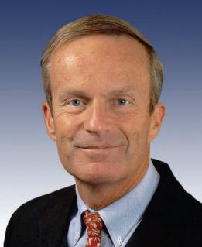
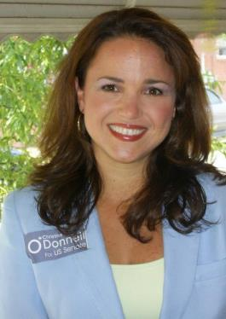
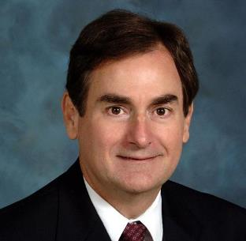

Slide 21
2024 Senate Ratings
Democratic Seats: 20 (plus 3 Independents)
Republican Seats: 11
SOLID D
LIKELY D
LEAN D
TILT D
TOSS UP
TILT R
LEAN R
LIKELY R
SOLID R
LEAN D
CA – (Butler)
CT – Murphy
DE – (Carper)
HI – Hirono
MA – Warren
ME – King (I)
MN – Klobuchar
NJ – Menendez
NM – Heinrich
NY – Gillibrand
RI – Whitehouse
VA – Kaine
VT – Sanders (I)
WA – Cantwell
MD – (Cardin)
AZ – (Sinema)
NV – Rosen
MI – (Stabenow)
PA – Casey
WI – Baldwin
OH – Brown
MT – Tester
TX – Cruz
NE – Fischer
FL – Scott
IN – (Braun)
MO – Hawley
MS – Wicker
ND – Cramer
NE – Ricketts
TN – Blackburn
UT – (Romney)
WV – (Manchin)
WY – Barrasso

Slide 22
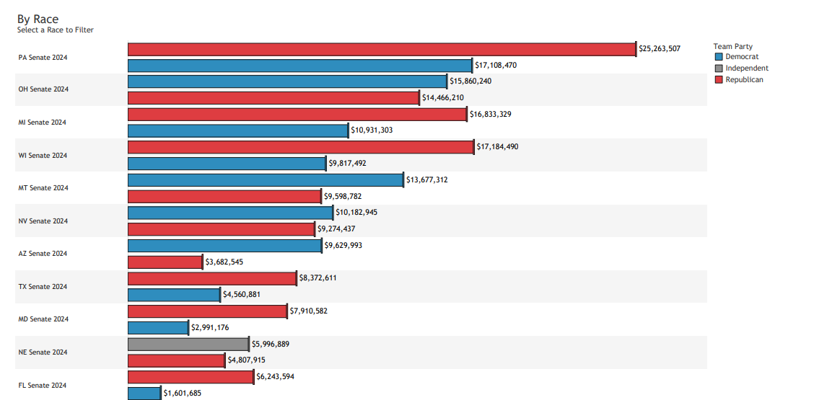

Slide 23
Candidates pay less for TV ads

Slide 24
Open Senate Seats
Arizona – Kyrsten Sinema (I)
California – Laphonza Butler (D)
Delaware – Tom Carper (D)
Indiana – Mike Braun (R)
Maryland – Ben Cardin (D)
Michigan – Debbie Stabenow (D)
New Jersey - George Helmy (D)
Utah – Mitt Romney (R)
West Virginia – Joe Manchin (I)
24

Slide 25
Fight for the House

Slide 26
2024 House Ratings
Democratic Solid Seats: 177
Republican Solid Seats: 188
LIKELY D
LEAN D
TILT D
TOSS UP
TILT R
LEAN R
LIKELY R
LEAN D
AL 2 – (Moore)
CA 9 - Harder
CA 49 – Levin
IL 17 – Sorensen
IN 1 – Mrvan
LA 6 – (Graves)
MD4 – (Trone)
MI 3 – Scholten
MN 2 – Craig
NH 1 – Pappas
NV 3 – Lee
NY 18 – Ryan
OR 4 – Hoyle
OR 6 – Salinas
PA 17 – Deluzio
TX 28 - Cuellar
CT 5 – Hayes
NY 22 – Williams
OH 13 – Sykes
TX 34 – Gonzalez
CA 13 – Duarte
NC 1 – Davis
NM 2 – Vasquez
NE 2 – Bacon
OH 9 – Kaptur
PA 7 – Wild
PA 8 – Cartwright
AK AL – Peltola
CA 27 – Garcia
CA 45 – Steel
CA 47 – (Porter)
CO 8 – Caraveo
IA 1 – Miller-Meeks
IA 3 – Nunn
ME 2 – Golden
MI 7 – (Slotkin)
MI 8 – (Kildee)
NY 4 – D’Esposito
NY 19 – Molinaro
OR 5 – DeRemer
VA 7 –(Spanberger)
WA 3 – Perez
AZ 1 – Schweikert
AZ 6 – Ciscomani
CA 22 – Valadao
CA 41 – Calvert
NJ 7 – Kean Jr.
NY 17 – Lawler
PA 10 – Perry
VA 2 – Kiggans
CO 3 – (Boebert)
MI 10 – James
MT 1 – Zinke
WI 3 – Van Orden
AZ 2 – Crane
CA 3 – Kiley
CA 40 – Kim
FL 13 – Luna
FL 27 – Salazar
NC 6 – (Manning)
NC 13 – (Nickel)
NC 14 – (Jackson)
NY 1 – LaLota
PA 1 – Fitzpatrick
TX 15 – De La Cruz
WI 1 – Steil

Slide 27
Opposition research is public

Slide 28
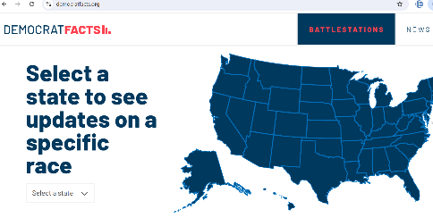

Slide 30
Majorities on the Line
House:
Democrats need +4
Current Outlook:
D+7 seats – R+6 seats

Slide 31
Fight for the States

Slide 32
2024 Governors Ratings
Democratic Seats: 3
Republican Seats: 8
SOLID D
LIKELY D
LEAN D
TILT D
TOSS UP
TILT R
LEAN R
LIKELY R
SOLID R
LEAN D
DE – (Carney)
WA – (Inslee)
NC – (Cooper)
NH – (Sununu)
lN – (Holcomb)
MO – (Parson)
MT – Gianforte
ND – (Burgum)
UT – Cox
VT – Scott
WV – (Justice)

Slide 33
For more information contact: jacob@insideelections.com InsideElections.com | @InsideElections | @jacobrubashkin

